Slide 1
Spacecraft, Spies, and Cyphers: How cryptography isn’t just for spies anymore
JP Burke and C. Schiff

Slide 2
About Your Humble Presenters
JP Burke
Works at Goddard Space Flight Center (GSFC) as a software developer on the ‘A-Train’, a constellation of Earth-observing spacecraft (Aqua, Aura, Terra)
Young, intelligent, works social media brilliantly, and spends a bit too much on his podcast (The Space Above Us)
Hopelessly devoted to subtitled anime
Conrad Schiff
Works also GSFC, currently as a plasma physicist on the Magnetospheric MultiScale (MMS) mission
(Also an adjunct physics professor at CTU)
Old, addled, but still productive (www.blogwyrm.com) and now officially a curmudgeon
Cleverly knows when to watch dubbed anime
Disclaimer: Our opinions are our own and not the official policy of the US Federal government, NASA, or a.i. solutions, Inc.

Slide 3

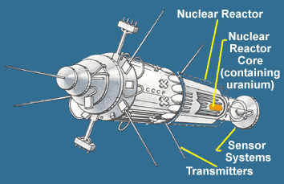
Secret Messages and Space – An Average Impression
Ask just about anyone what images come to mind with the two words ‘Secret Messages’ and ‘Space’ you’ll likely get something like:
Kosmos 854, the Soviet spy satellite that rained radioactive debris over northern Canada in 1978
Death from above scenarios like this scene from the movie Real Genius

Slide 4
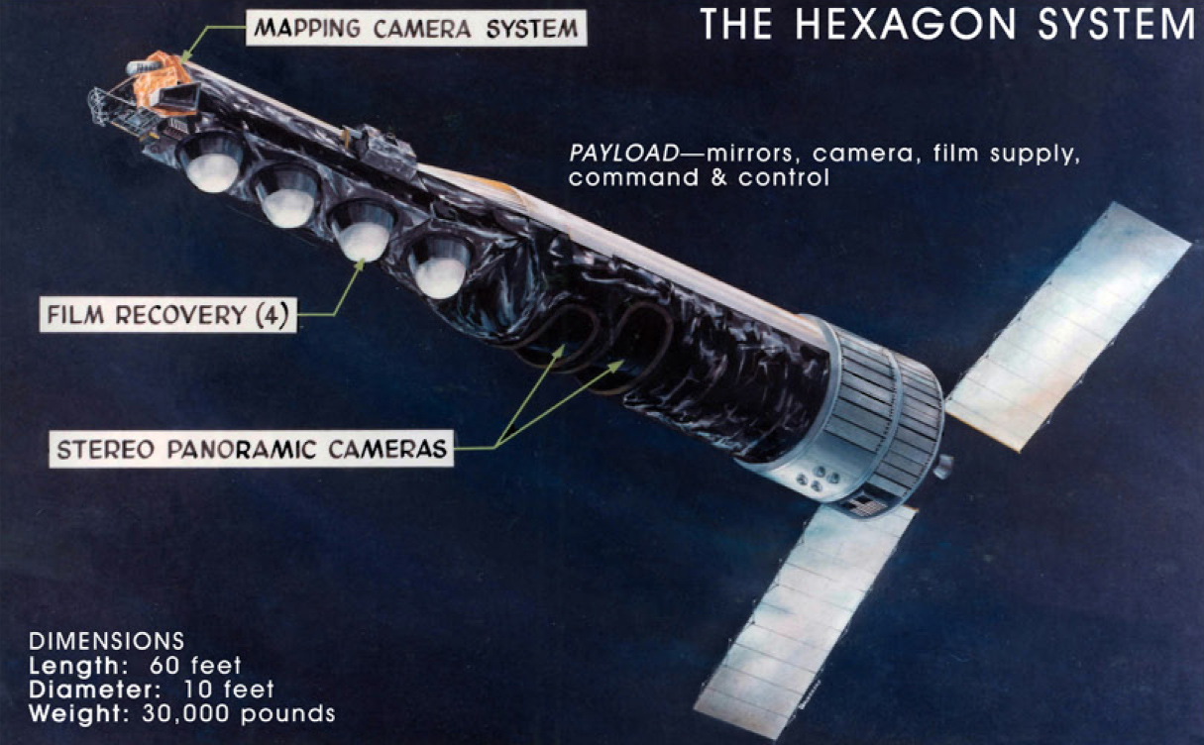
1971-1986
Notes:
KH-9 spy satellite. Codename HEXAGON. Difference between normal satellite and “spy” satellite?

Slide 5
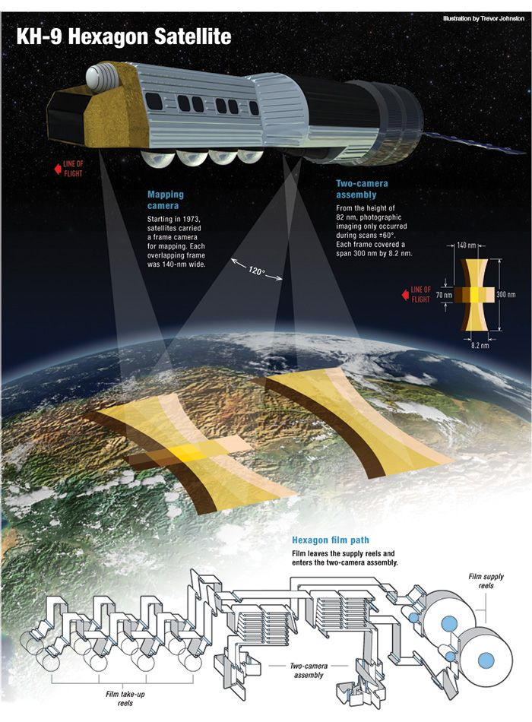
Notes:
Fly along, take photos

Slide 6
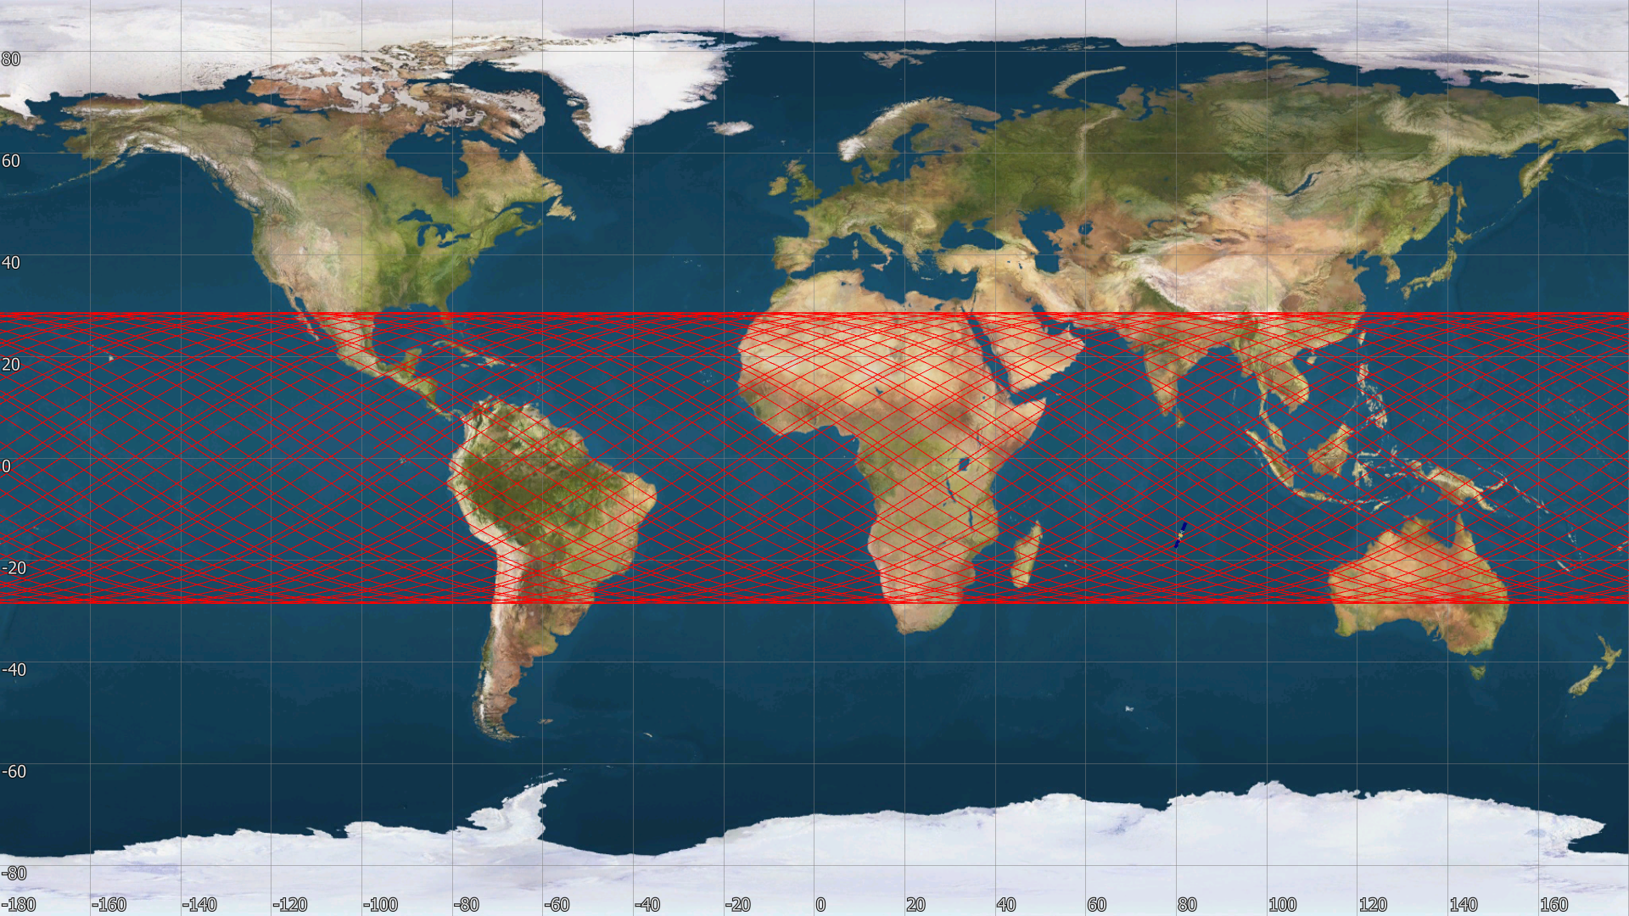
Notes:
Talk about effect of inclination on ground track

Slide 7
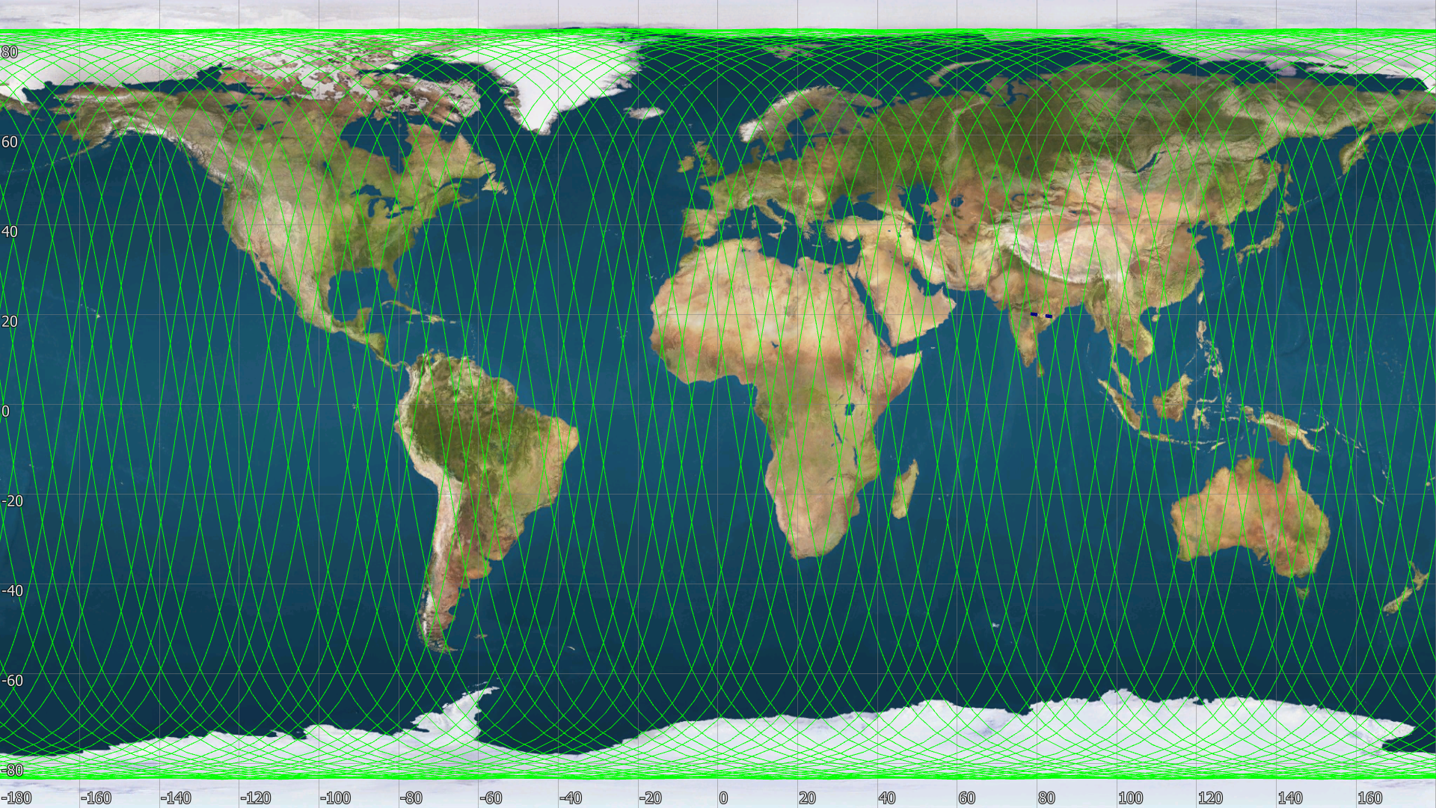

Slide 8
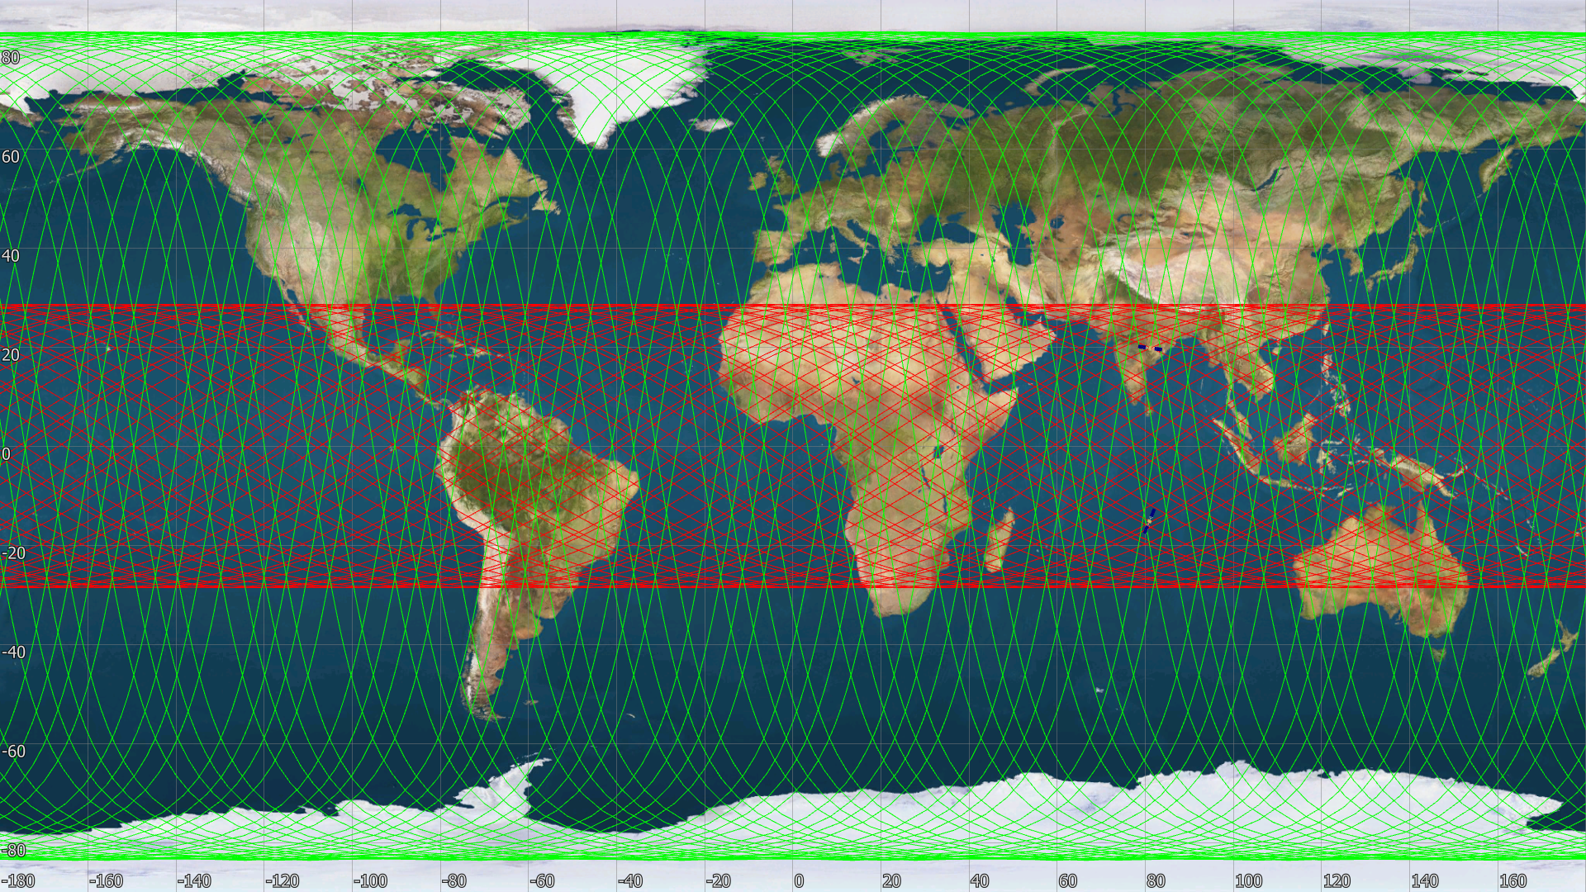

Slide 9
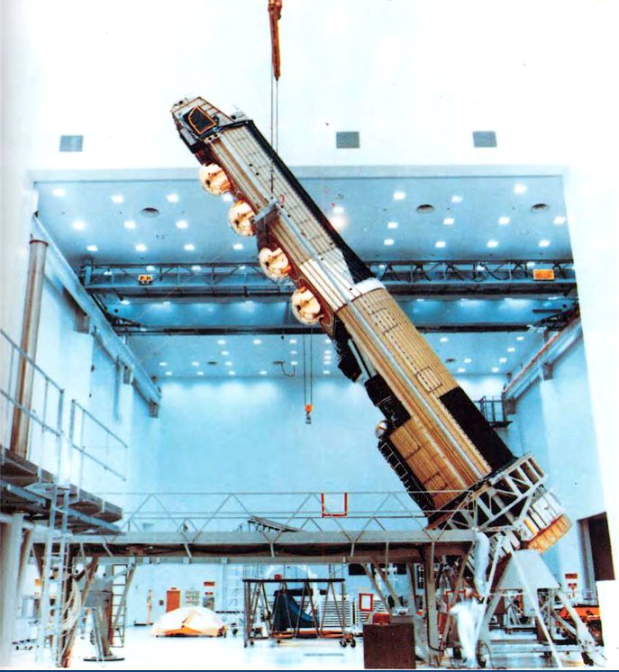
Notes:
What was it doing

Slide 10
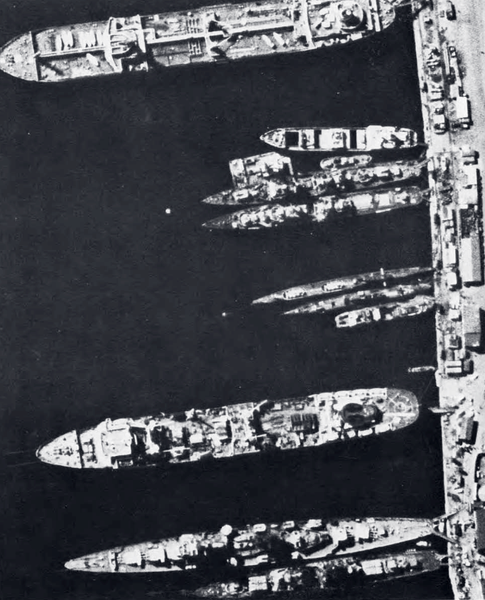
Notes:
What was it doing

Slide 11
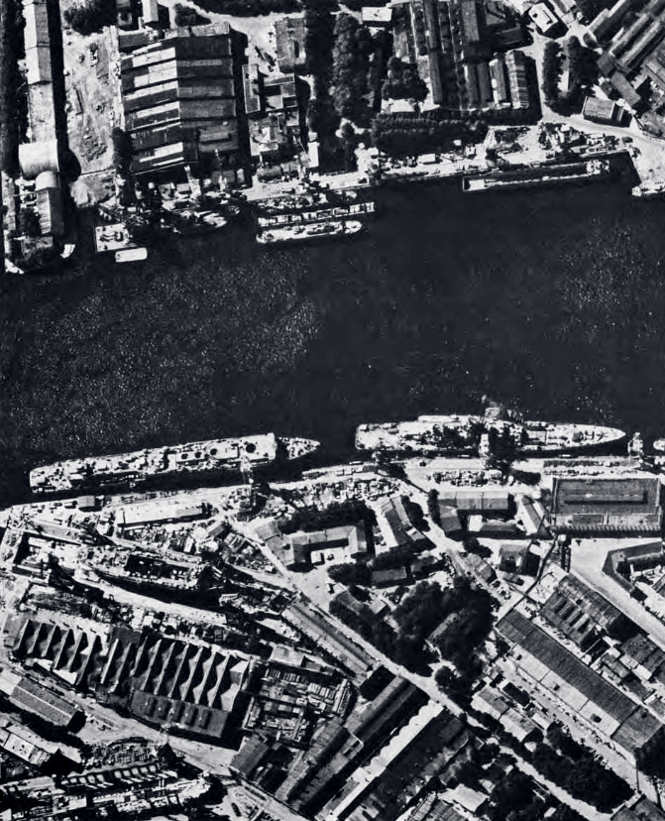
Notes:
What was it doing

Slide 12
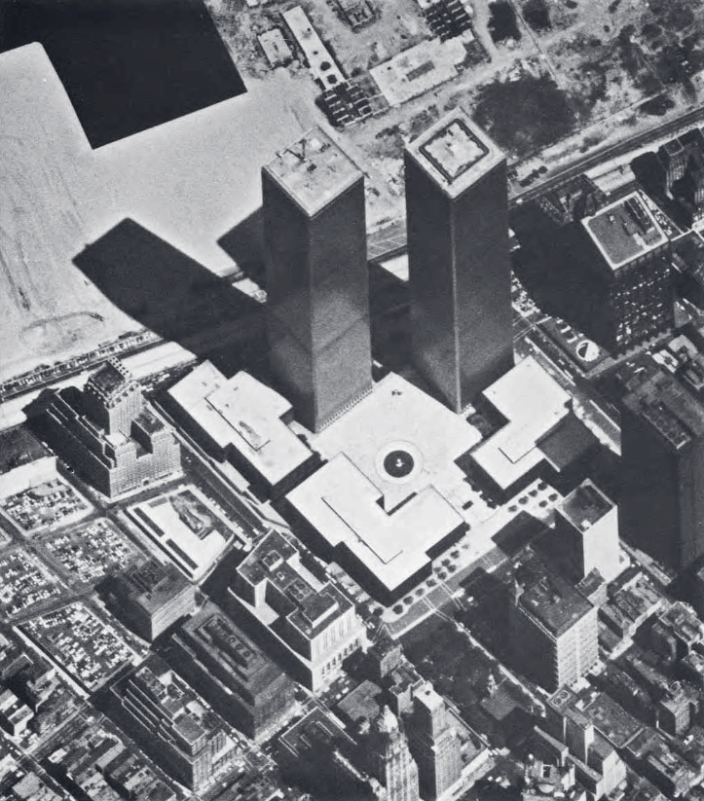
Notes:
What was it doing

Slide 13
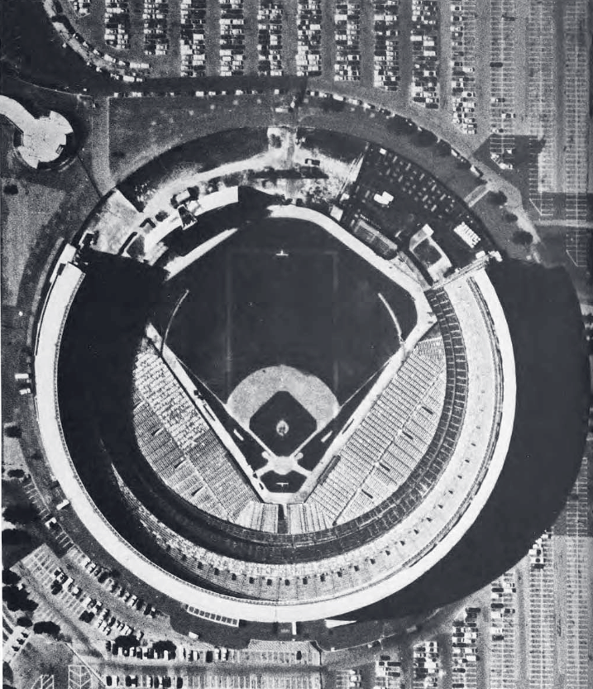
Notes:
What was it doing

Slide 14
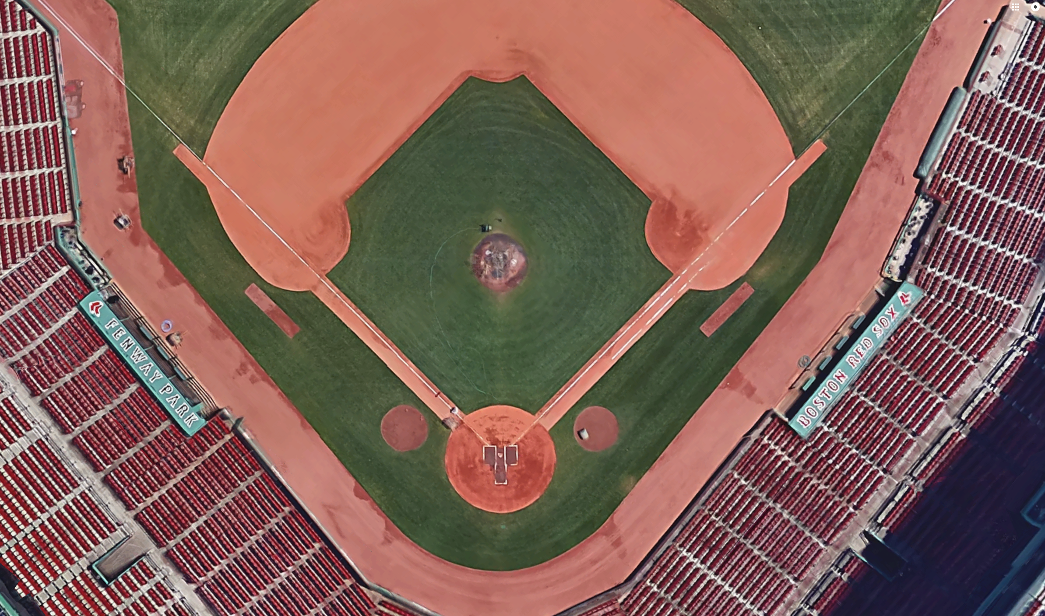
Notes:
What was it doing

Slide 15
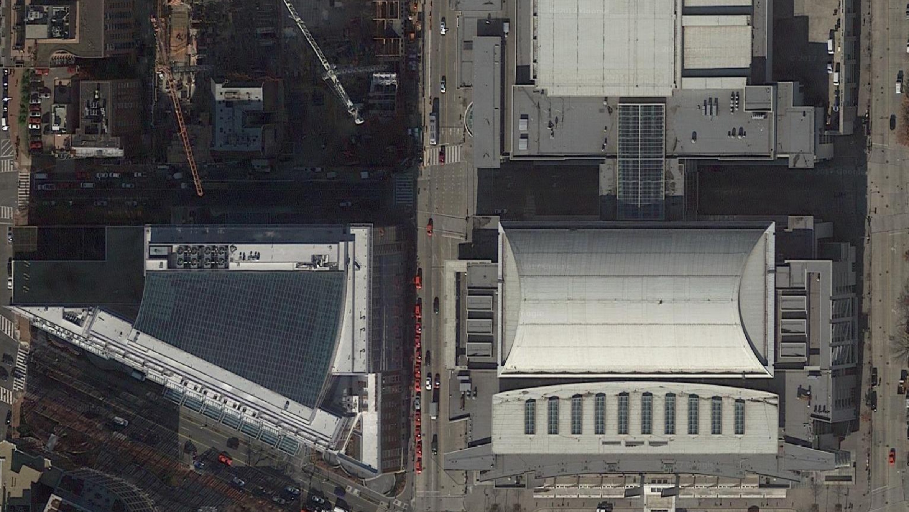
Notes:
What was it doing

Slide 16
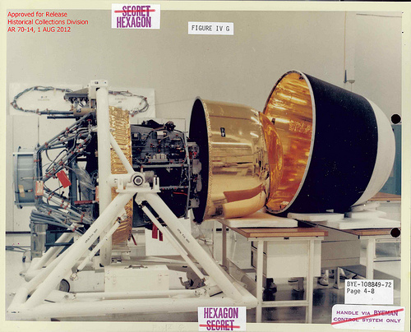
Notes:
What was it doing

Slide 17
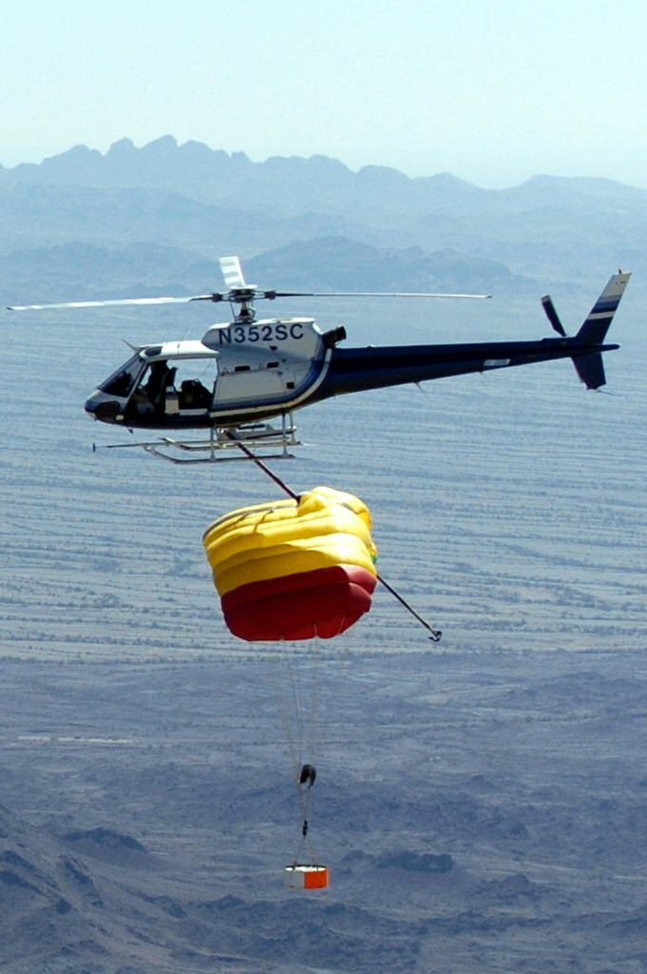
Notes:
What was it doing

Slide 18
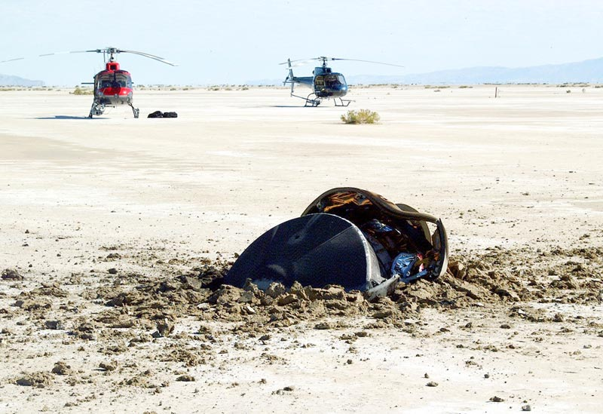
Notes:
What was it doing

Slide 19
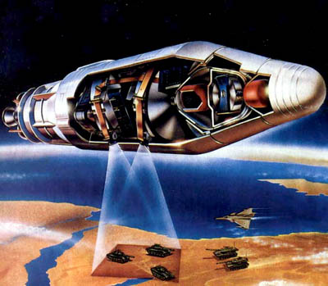
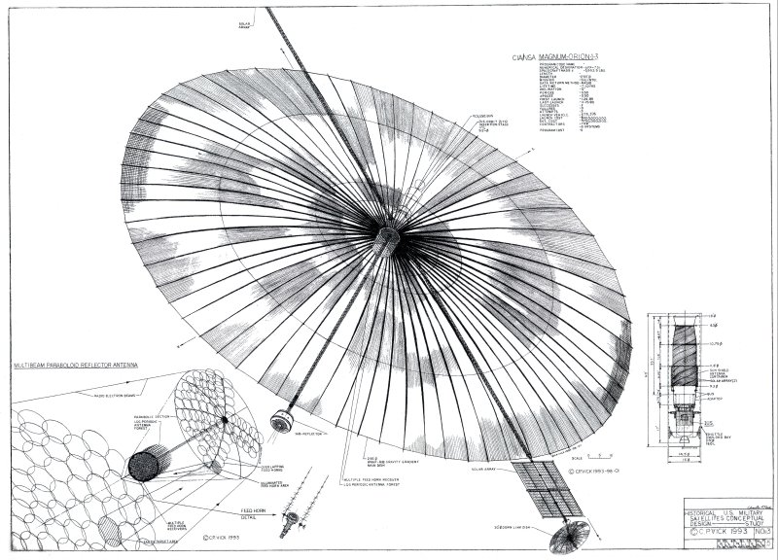
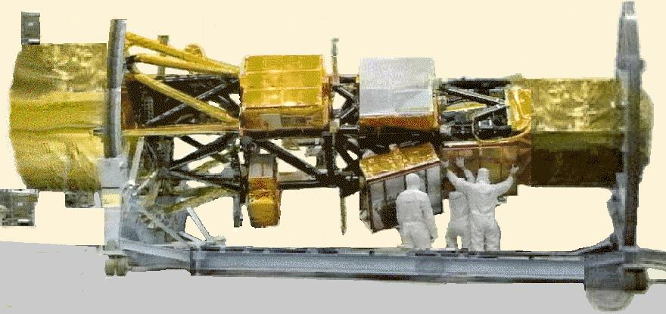
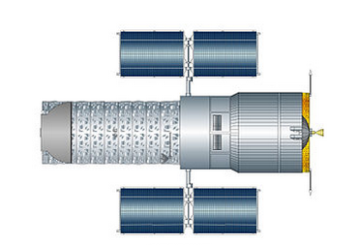

Slide 20
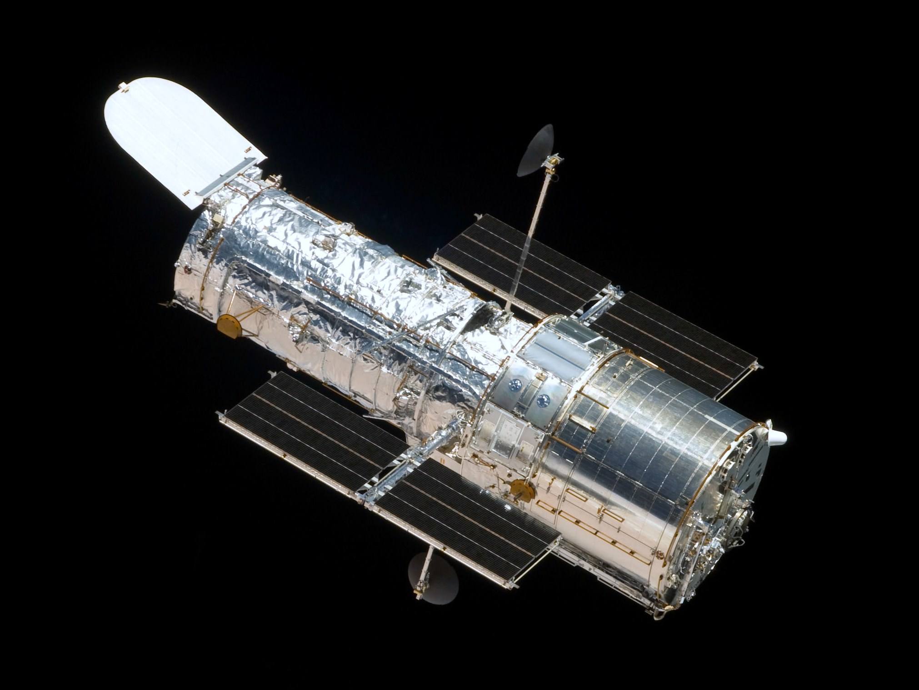

Slide 21
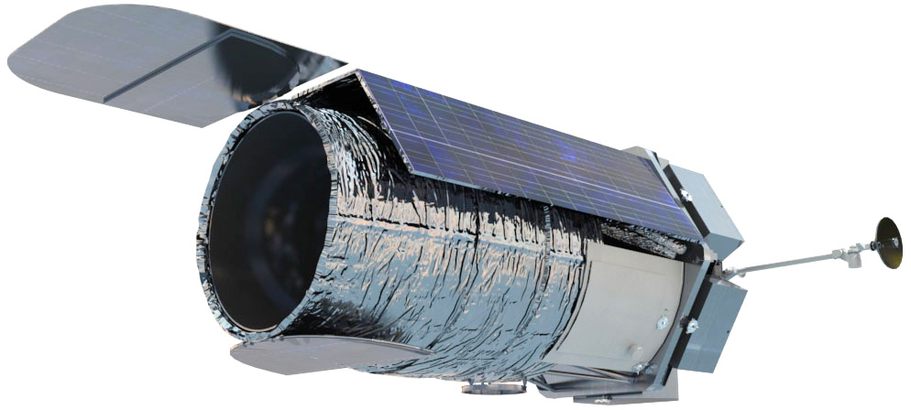
WFIRST
Wide Field Infrared Survey Telescope

Slide 22
But Secret Messages Aren’t Just for Spies
Of course modern world is filled with the need for both encoded messages and encrypted messages, even if they aren’t directly spy-related
Encoded messages – idea and concepts put into a format that can be shared between people
Spoken and written language
Mathematics, science, and engineering
Music, poetry, painting, etc.
Monetary and financial transactions
Computer communications
Encrypted messages – ideas and concepts put into a format that is intentionally aimed at securing a communication from the sender (Alice) to the recipient (Bob), excluding everyone else (Eve)
Spies, national security, state department communiques
SSH, secure online purchases
Sensitive data (SSN, medical history, etc.)
Spacecraft commands and communication

Slide 23

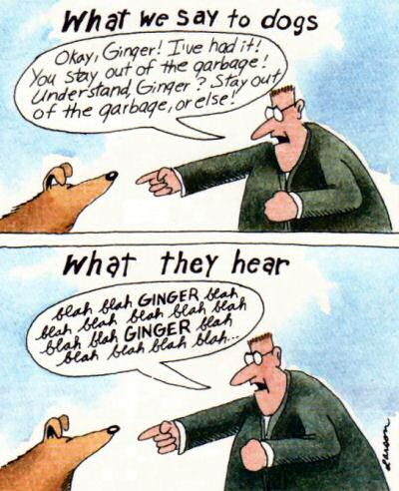
Encoding – Who Needs It?
What water?
Encoded messages are the central part of our communications – so much so that we don’t notice the encoding
All language is like that whether it is human (spoken, written, drawn, etc.), animal, computer, advertising, and so on
Encoded messages can seem like encrypted ones until you ‘learn’ how to decode
Consider this scene from Haibane Renmei

Slide 24


Slide 25


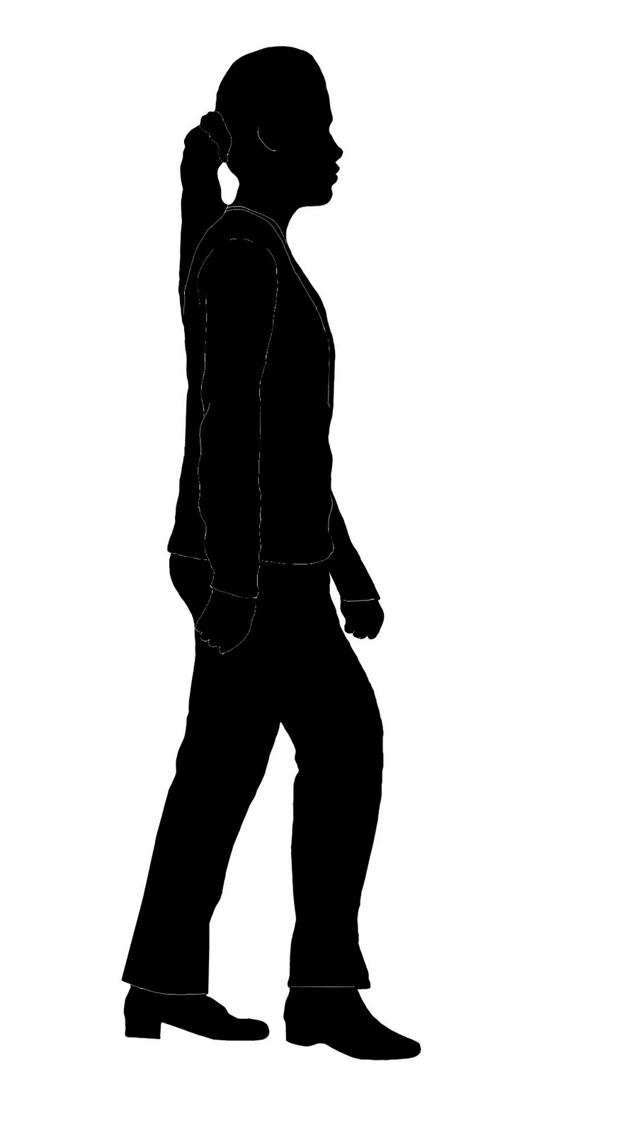



Alice, Bob and Eve
Alice
Bob
In the traditional lingo of cryptography there are four ingredients
Alice – person who wants to send a private message
Bob – person who want to receive a private message
Eve – person who wants to know what’s in the message and/or wants to spoof the message
The message
Successful cryptography would mean that Alice can send Bob a message confident that even if the message were intercepted that Eve can break it
Eve

Slide 26
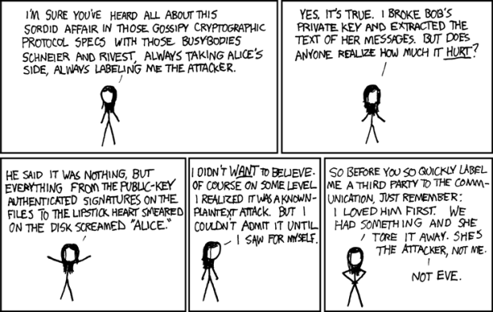
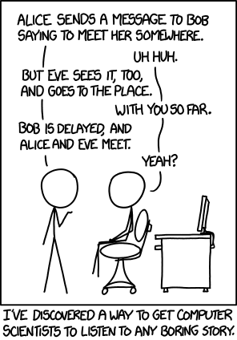
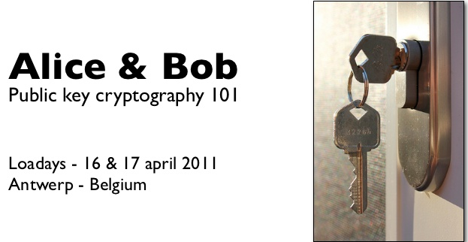
There is a whole culture devoted to Alice, Bob, and Eve
The trials, travails, and other sordid details of Alice’s, Bob’s, and Eve’s ‘soap opera’ have captured the attention of even the most stuffy of mathematicians, physicist, and computer scientists
Source:
https://vicky2183.wordpress.com/2010/06/08/interesting-characters-in-cryptography/
http://www.bookrags.com/wiki/Alice_and_Bob
Xkcd.com

Slide 27
Substitution Ciphers
Before the advent of computers, the primary encryption scheme was the substitution cipher
Simplest example: single, unique one-to-one substitution of one letter for another:
iqrrxxjoaxc
iqrrx xjoaxc
Hello Otakon
More sophisticated schemes use multiple, unique one-to-one substitutions
a | b | c | d | e | f | g | h | i | j | k | l | m | n | o | p | q | r | s | t | u | v | w | x | y | z
o | b | t | k | q | m | e | i | h | y | a | r | f | c | x | p | z | v | u | j | n | l | s | w | g | d

Slide 28
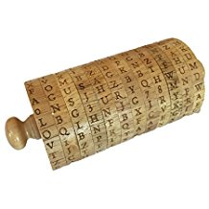
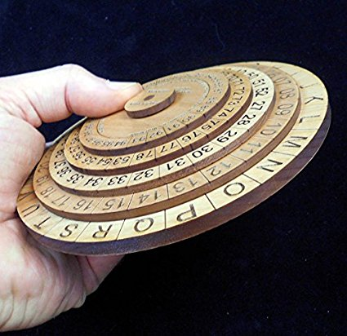

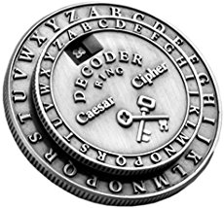
Substitution Cipher Devices

Slide 29
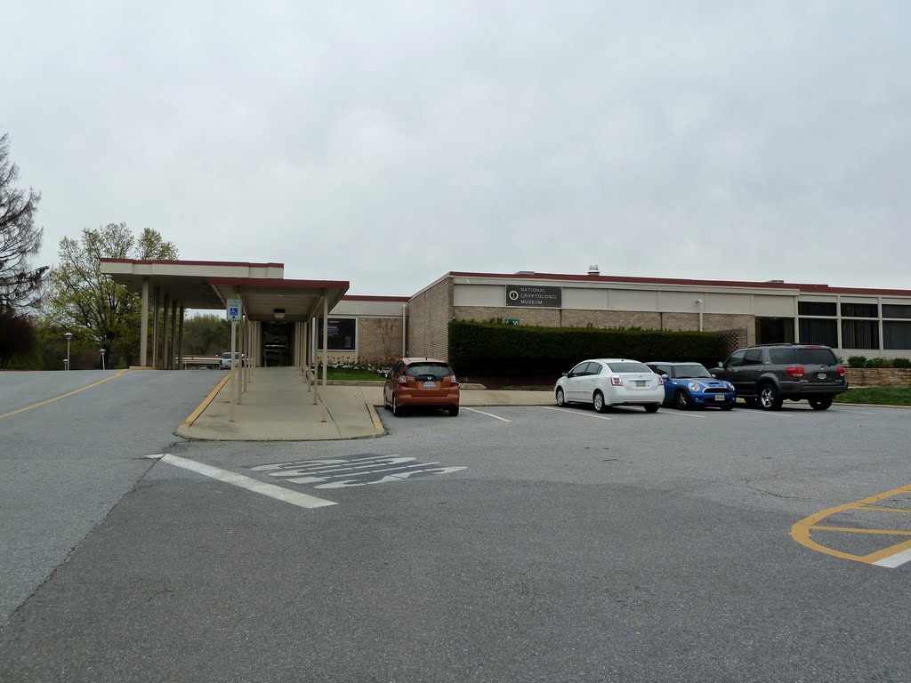
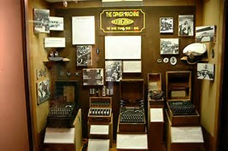
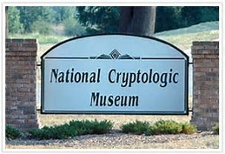
Cryptological Museum
The National Cryptological Museum is a place where you can learn more about cryptography, the historical uses, and play with an Enigma machine
Run by the National Security Agency
Is located on MD Route 32 near Fort Meade

Slide 30

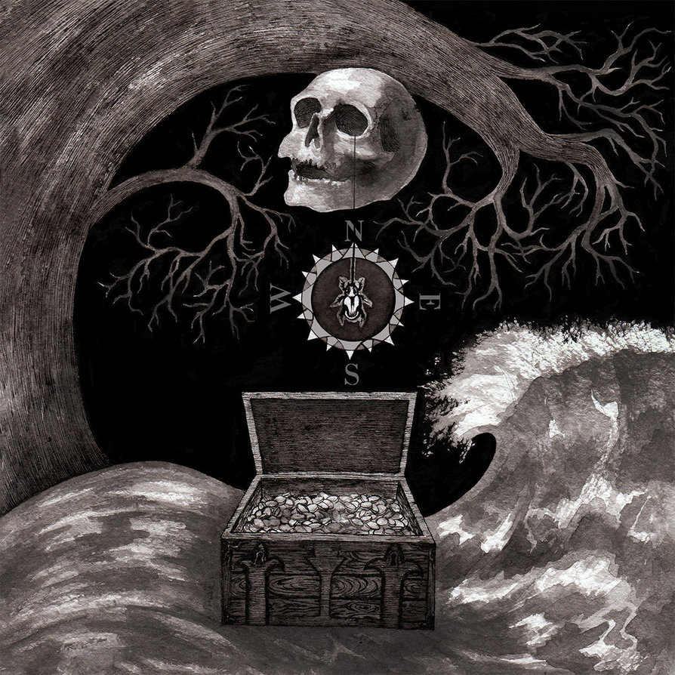
Some of the Problems
Substitution ciphers have problems
First are the logistic problems
Alice and Bob need to know which key they are to use
They need to hide it from Eve
How do they agree on the key when they are far apart – do they need to encode the key in a secret message? (keys all the way down)
Second there are security problems - substitution ciphers are fairly easy to crack
Helps when you know the language of the code (see Edgar Allen Poe’s The Gold Bug)
Letter frequency is a big clue
Same key is used to encode as to decode

Slide 31


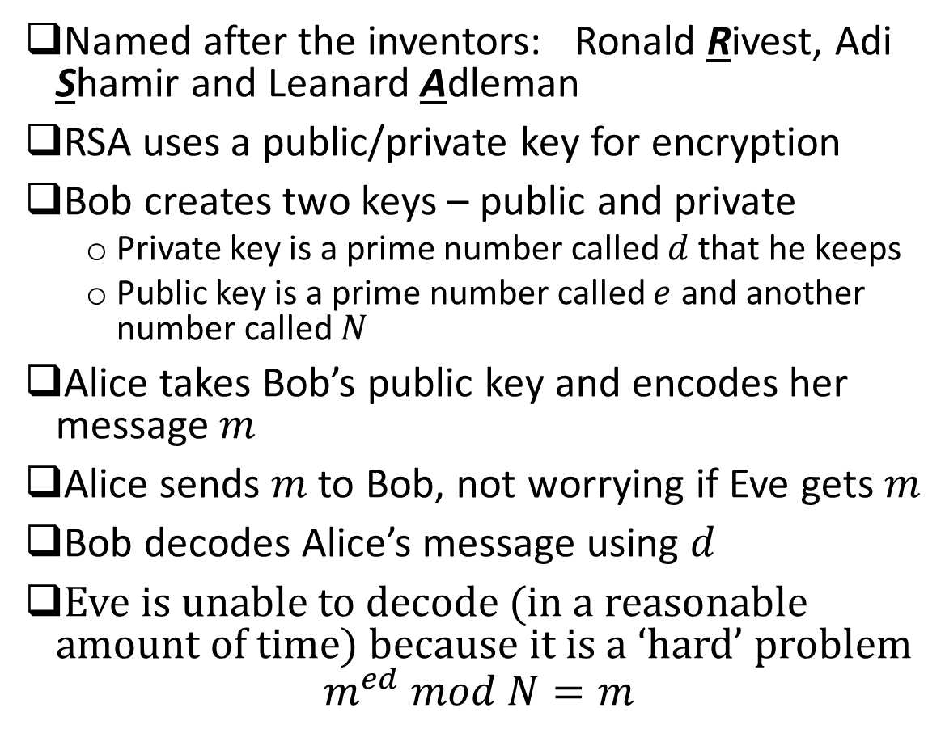
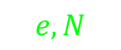

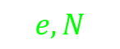
RSA Encryption
$$d$$
Alice
Bob
$$e, N$$
Named after the inventors: Ronald Rivest, Adi Shamir and Leanard Adleman
RSA uses a public/private key for encryption
Bob creates two keys – public and private
Private key is a prime number called $d$ that he keeps
Public key is a prime number called $e$ and another number called $N$
Alice takes Bob’s public key and encodes her message $m$
Alice sends $m$ to Bob, not worrying if Eve gets $m$
Bob decodes Alice’s message using $d$
Eve is unable to decode (in a reasonable amount of time) because it is a ‘hard’ problem
$$m^{ed} mod N=m$$
$$m$$
$$m$$
$$e, N$$
http://doctrina.org/How-RSA-Works-With-Examples.html
https://www.youtube.com/watch?v=wXB-V_Keiu8
Eve

Slide 32
An Aside
There is a certain irony in the RSA encryption algorithm being a practical application of number theory (modular arithmetic, totients, Fermat’s little theorem, Euler’s theorem, etc.)
In 1940, G. H. Hardy wrote a mathematicians apology, one theme of which was (quoting the Wikipedia article)
For Hardy, the most beautiful mathematics was that which had no practical applications in the outside world (pure mathematics) and, in particular, his own special field of number theory.
It is interesting to reflect on what Hardy would be thinking if he were alive today to see much of the internet running on number theory

Slide 33
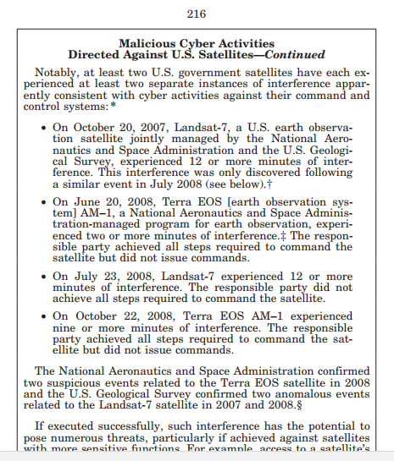
Encryption and Spacecraft
Now return to the subject of encryption and spacecraft
NASA spacecraft have been subjected to malicious hacking over the years
Interfere with valuable national scientific assets
Waste of time, money, and consummbles
NASA wants to protect itself from situations like the following

Slide 34
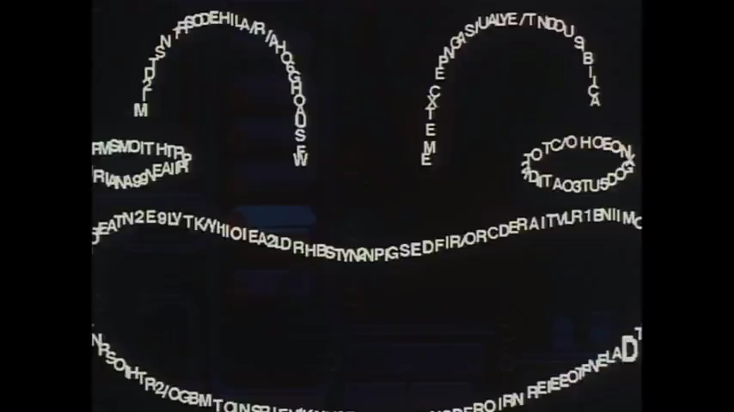

Slide 35
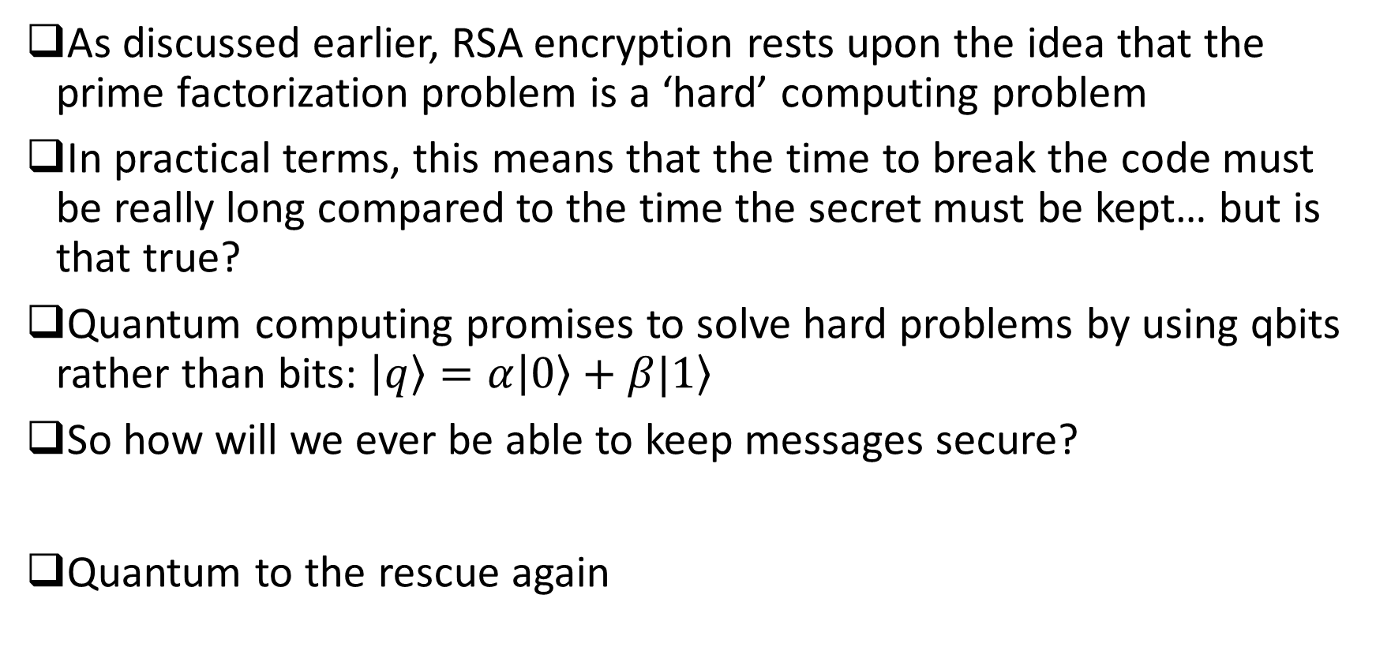
Unbreakable Codes
As discussed earlier, RSA encryption rests upon the idea that the prime factorization problem is a ‘hard’ computing problem
In practical terms, this means that the time to break the code must be really long compared to the time the secret must be kept… but is that true?
Quantum computing promises to solve hard problems by using qbits rather than bits: $\left|\left.q\right\rangle =α\right|\left.0\right\rangle +β|\left.1\right\rangle$
So how will we ever be able to keep messages secure?
Quantum to the rescue again

Slide 36
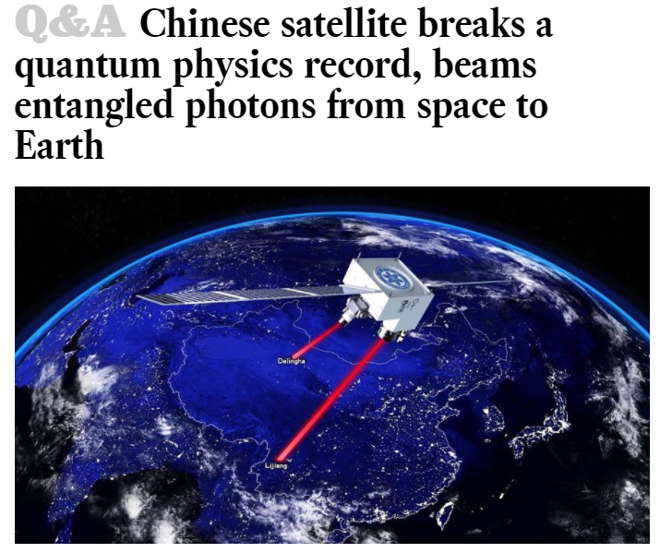
Entanglement and encryption
By using a concept called quantum entanglement, Eve can send a message to Bob that only he can decode
Entanglement, in simple terms, means that two physical systems are linked so that a measurement on one forces a measurement on another
China is leading the way on this particular technology

Slide 37

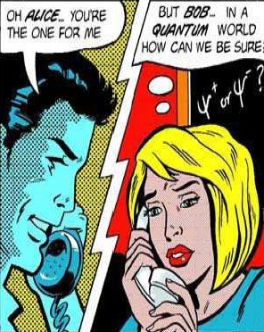

Slide 38
Top Secret
Questions?

